Slide 1
Cape Town State Warehouse ICD Presentation

Slide 2
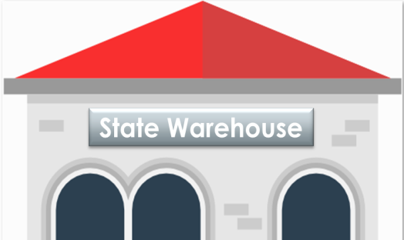
Background - The State Warehouse Refurbishment Programme
The State Warehouse Refurbishment Programme was initiated in 2014/15 Financial Year and was implemented at prioritised sites as an endeavour to ensure alignment to the Customs Mandate:
Beitbridge
Musina
Groblers'bridge
Lebombo
ORTIA
Cape Town
Durban
Karsene
Partner in enhancing South Africa’s economic growth
Customs Mandate
Provide first-line of control over the movement of goods across our country’s borders
Promote South Africa as a safe and trusted trading partner and investment destination

Slide 3
Our Vision
‘Together, taking Customs to greater heights’
Customs that achieves 100% detection rate on illicit trade
Exceeds revenue target by higher margins
Make use of relevant technology to improve service delivery
Have highly committed, effective and professional teams that create a positive cross-border experience for all travellers and traders
Become a global reference point

Slide 4
Enabling Models Towards Building World-Class State-Warehouses
World Class
Optimisation
Predictability
The immediate focus of the Turnaround programme is to drive the Repeatability milestone – standardising and addressing ‘noise’ in the system
Repeatability
Reward:
Recognised by
traders, clients, employees, peers
and other stakeholders
as the industry leader in Customs warehouse operations
Dynamic:
Lean Methodology will drive effective on-time delivery, cost management, enablement of strategic objectives and “real-time” management tools e.g. Six Sigma DMAC Methodology
Integrate:
Integrated systems to enable high levels of certainty across all levels of operational performance, use of bar code scanners, RFID etc.
Standardise:
Executing in the same manner, across all SWH processes, every-time. Keep it simple, drive concept like 5S, visual management etc.
Change and Communication Management is integral to, and underpins the success of the Journey, particularly during the Repeatability and Predictability stages

Slide 5
Cape Town State Warehouse Programme
Project Journey began in September 2016. Cape Town’s State Warehouse was one of the 8 prioritised sites Identified during the State Warehouse Programme.
The End-to-end Warehouse Refurbishment activities included the following:
Upgrade of existing offices.
Introduction of Racking and Shelving
Electrical Supply to enhance warehouse lighting and improvement of Risk Control measures
Enhance capacity and storing for the following areas:- general storage per commodity segmentation, high value, hazardous, and bulk goods storage areas,
Improved Client Interface Area
Technology Infrastructure upgrades - The patch room was moved from the 1st floor to the ground floor to host Network and Security cabinets, UPS, Air conditioners and other IT equipment.
Upgraded Technical Security (Control Rooms, Access Control, CCTV, Electrical Fencing, Caging of the Operational Space to improve Risk Management Controls) Installation of the Aluminium Water Tanks, to support the upgraded Fire System due to the Water shortage challenges in Cape Town).
Enhanced the SWH Inventory management approach (DA322 improved to a spreadsheet and migrated into SWIMS).
The new state warehouse process enables Customs to publish dated stats of goods on the SARS website.
Introduction and implementation of the Lean Methodology and 5s.(A 5S program focuses on having visual order, organisational cleanliness and standardisation

Slide 6
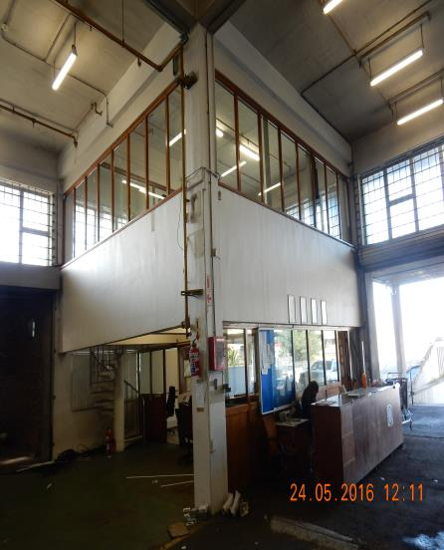
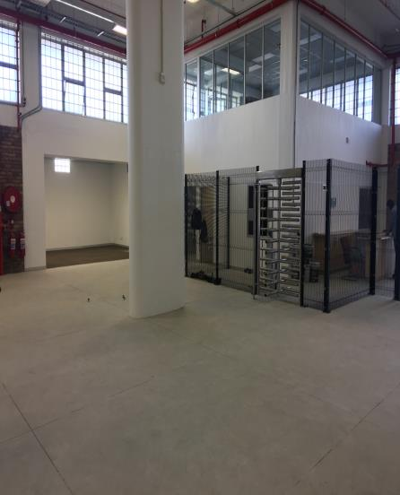
CAPE TOWN JOURNEY
BEFORE
AFTER

Slide 7
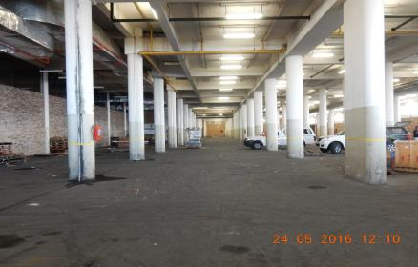
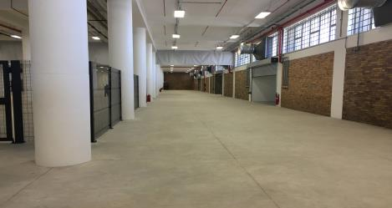
CAPE TOWN JOURNEY
BEFORE
AFTER

Slide 8
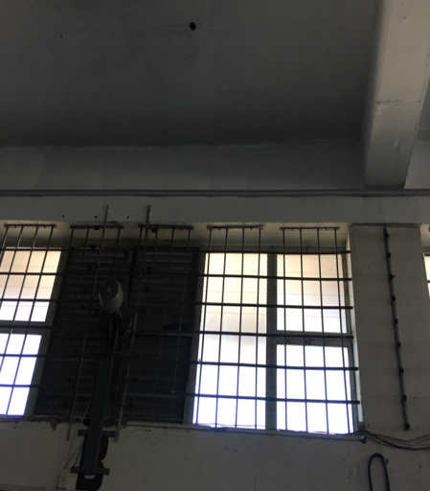
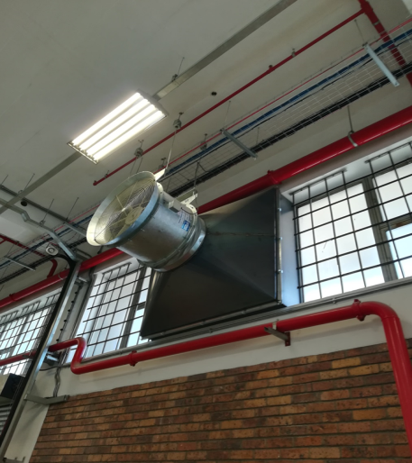
CAPE TOWN JOURNEY
BEFORE
AFTER

Slide 9
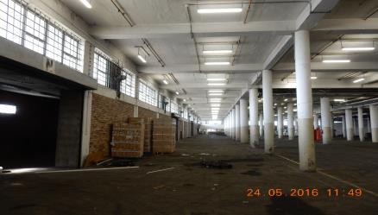
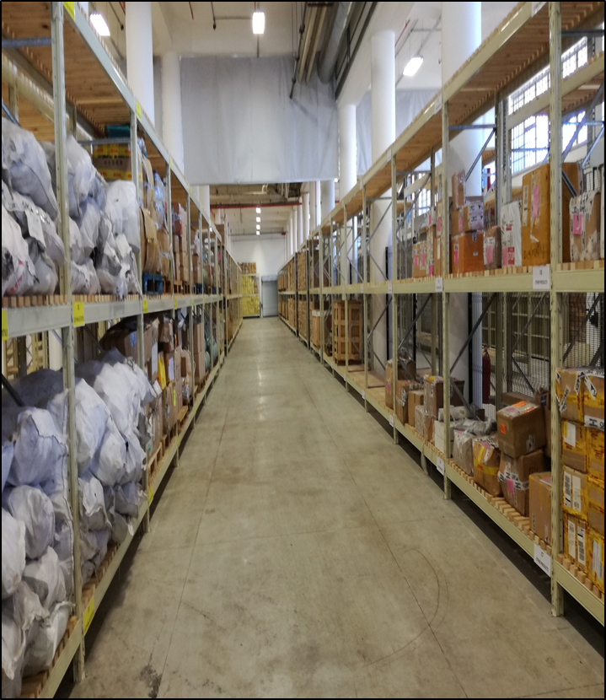
CAPE TOWN JOURNEY
BEFORE
AFTER

Slide 10
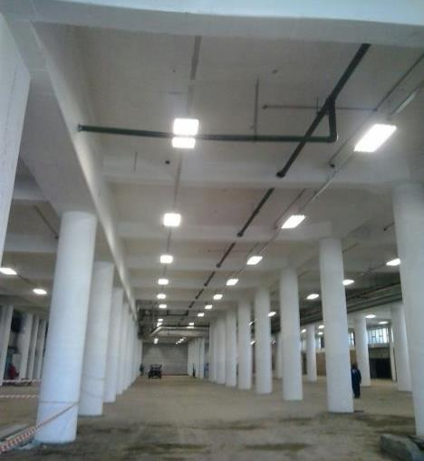
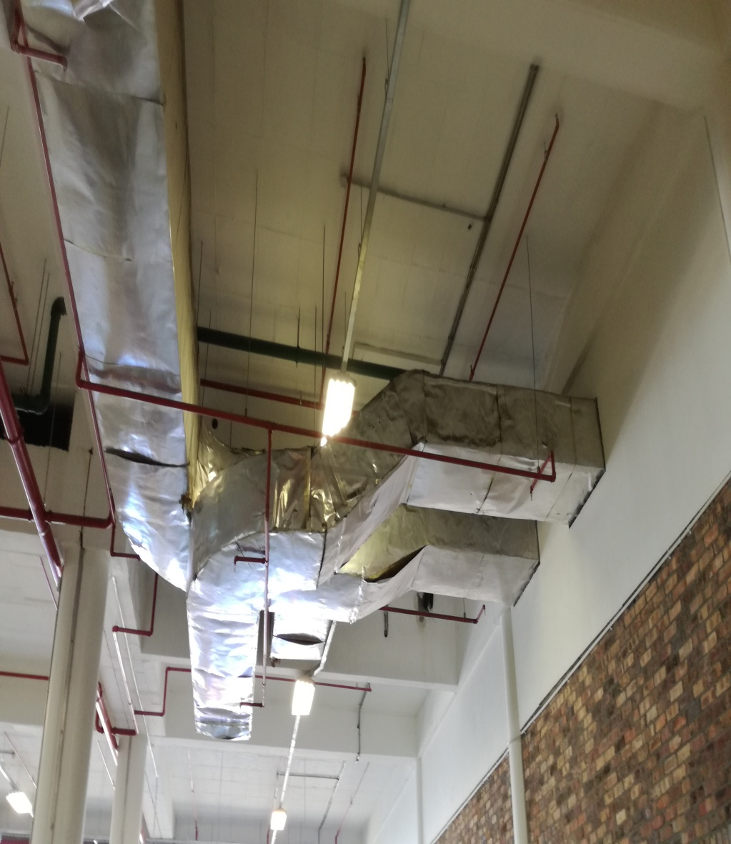
CAPE TOWN JOURNEY
BEFORE
AFTER

Slide 11
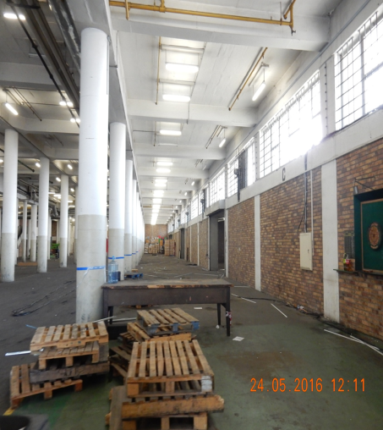
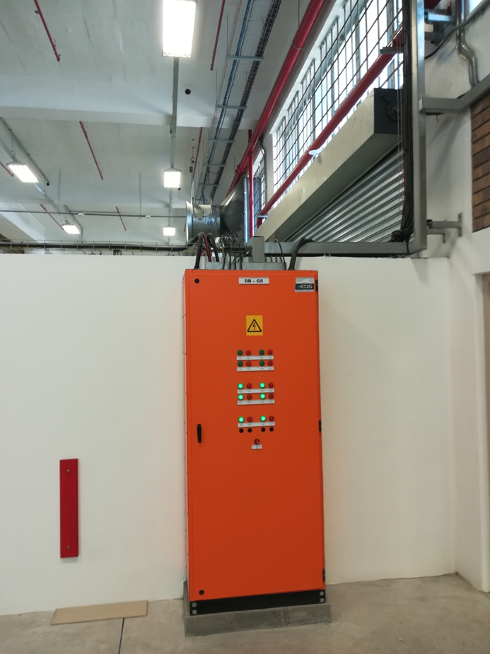
CAPE TOWN JOURNEY
BEFORE
AFTER

Slide 12
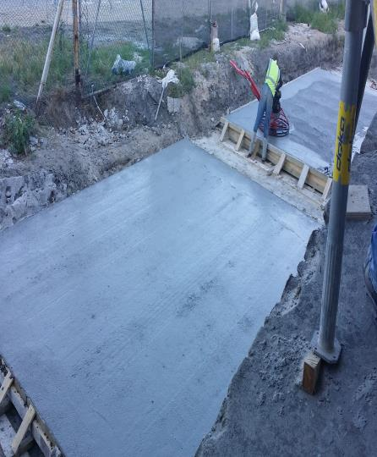
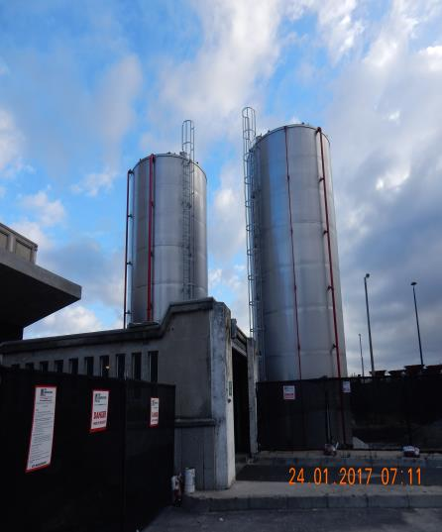
CAPE TOWN JOURNEY
BEFORE
AFTER

Slide 13
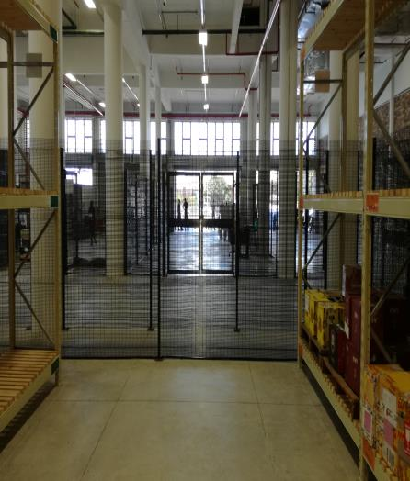
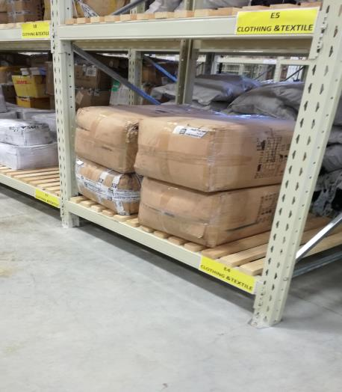
CAPE TOWN JOURNEY
AFTER

Slide 14
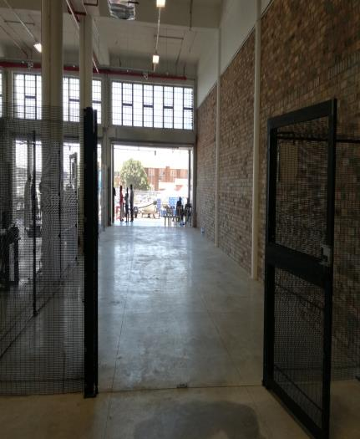
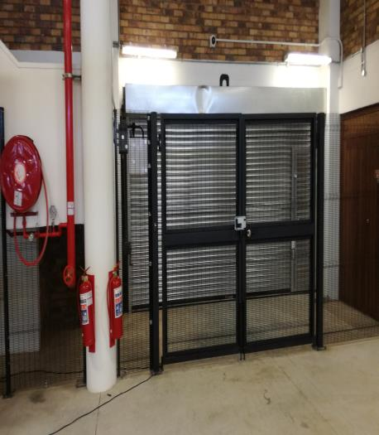
CAPE TOWN JOURNEY
AFTER

Slide 15
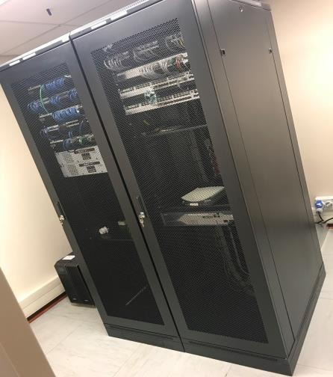
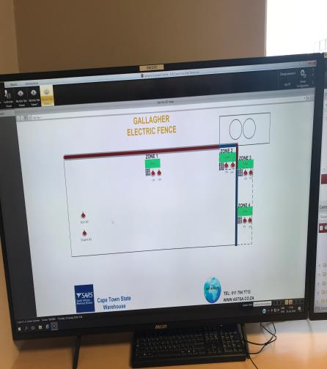
CAPE TOWN JOURNEY
AFTER

Slide 16
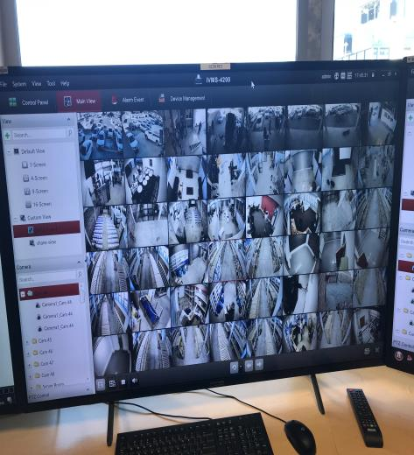
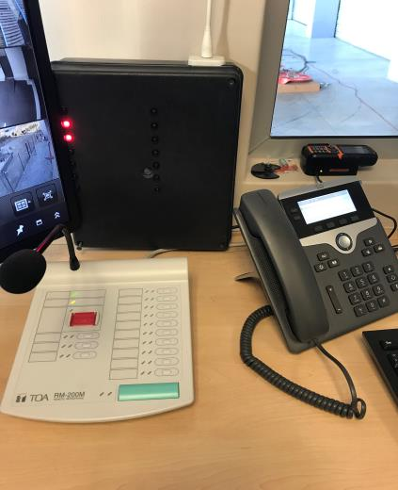
CAPE TOWN JOURNEY
AFTER

Slide 17
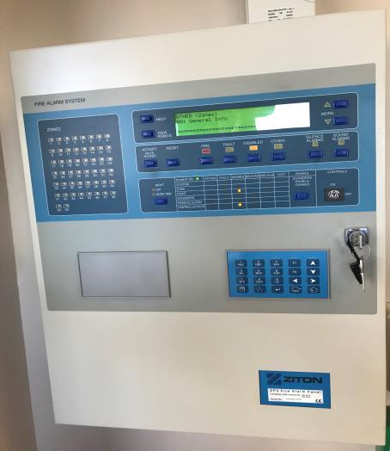
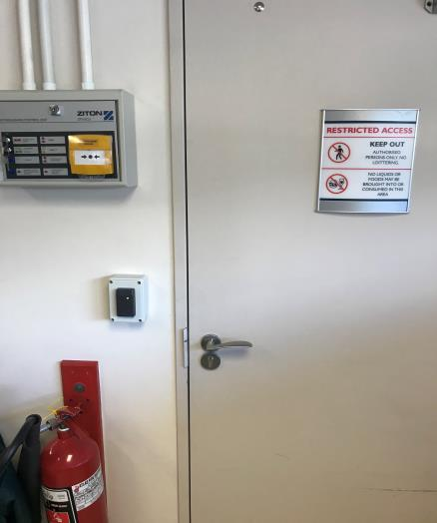
CAPE TOWN JOURNEY
AFTER

